Slide 1
Environmental Health Problems

Slide 2
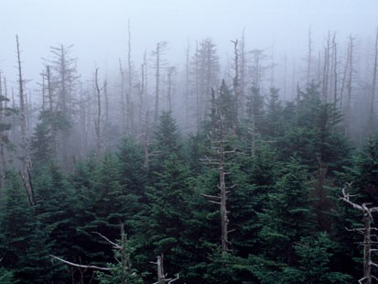

Slide 3
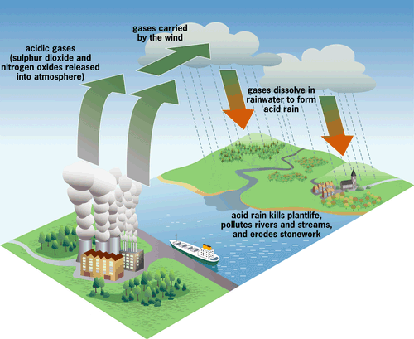
Acid Rain
Notes:
Emphasize that pollution is directly linked to Acid Rain, which destroys plant life, pollutes rivers, and erodes stonework.

Slide 4
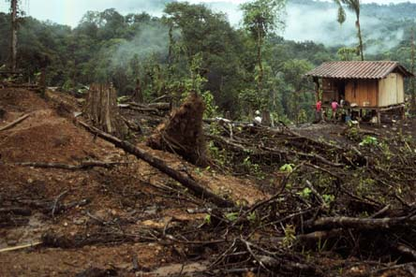

Slide 5
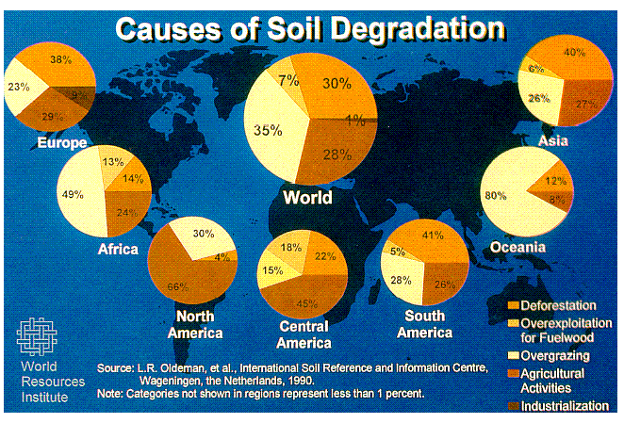
Land degradation
Notes:
Emphasize that Industrialization and Deforestation are the leading causes of Soil Duration. These two aspects are directly linked with humans consumption of raw materials.

Slide 7
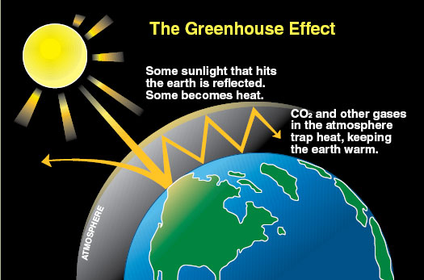
Greenhouse Effect

Slide 9
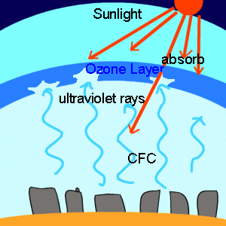
Depletion of Ozone Layer
Notes:
Be sure to emphasize that due to the depletion of the Ozone Layer, humans are more susceptible to UV rays, making over exposure to sunlight a greater concern.

Slide 11
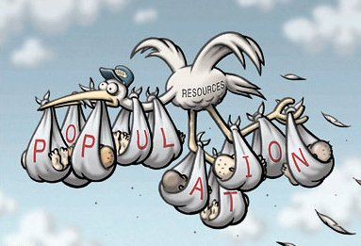
Overpopulation 3-7billion from 1960-2011
Notes:
Simply emphasize that we live in a world of limited resources.

Slide 12
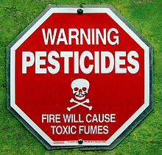

Slide 13
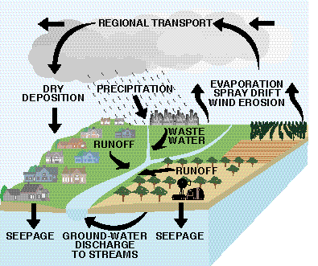
Water Pollution
Notes:
Emphasize that Water pollution is not only cause from oil spills and activity that happens in the ocean. Explain through this image that what happens on land can negatively impact our planets aquatic life and water sources.

