Slide 1
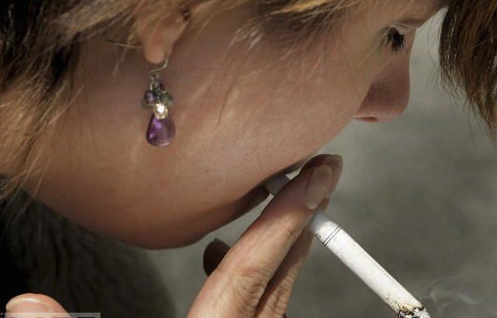
What will it take to prevent tobacco use by young people?
http://www.realityunfiltered.com/#
**Note: Slide must be in display mode to play.**

Slide 2
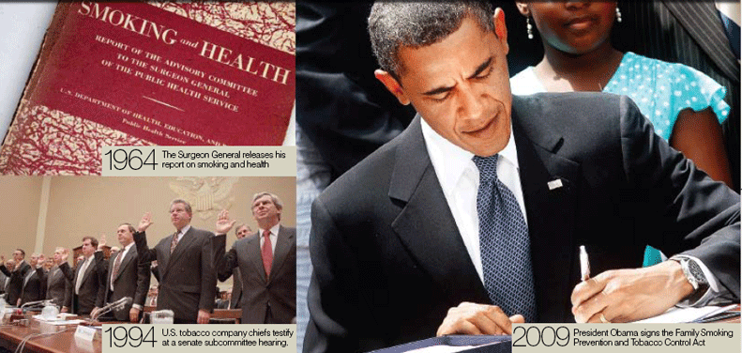
Laws and Policies about Tobacco Use

Slide 3
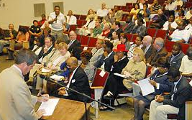
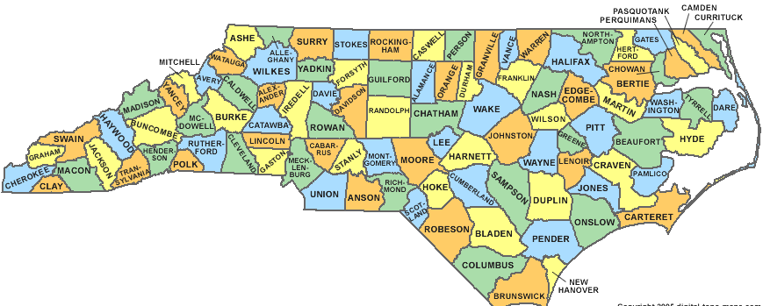
Levels of Government Authority
Local
State
National

Slide 4
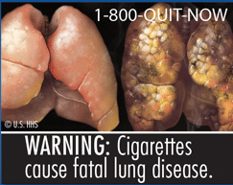
Risks for Smokers
Death
Addiction
Lung disease
Cancer
Stroke
Heart disease
Harm to baby if pregnant mother smokes

Slide 5
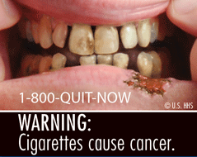
Risks for Spit Tobacco Users
Mouth cancer
Gum disease
Tooth loss
Addiction
*Not a safe alternative to smoking

Slide 6
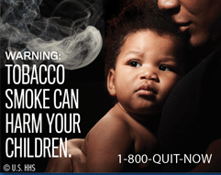
Risks of Secondhand Smoke for Non-Smokers
Heart disease
Cancer
Bronchitis
Pneumonia
Asthma

Slide 7
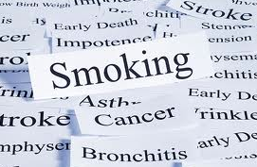
Intent of Laws and Policies
To reduce youth smoking
To encourage adult smokers to quit
To reduce non-smokers’ exposure to secondhand smoke
To require truth in labeling and advertisements
To reduce the financial costs of tobacco-related diseases
To reduce injury and premature death from tobacco-related diseases

Slide 8
Woman in Restaurant
Will everyone in the restaurant PLEASE
stop coughing?

Slide 9
January 2010
North Carolina’s ban on smoking in restaurants went into effect.
Families can enjoy a meal without being exposed to dangerous secondhand smoke.

Slide 10
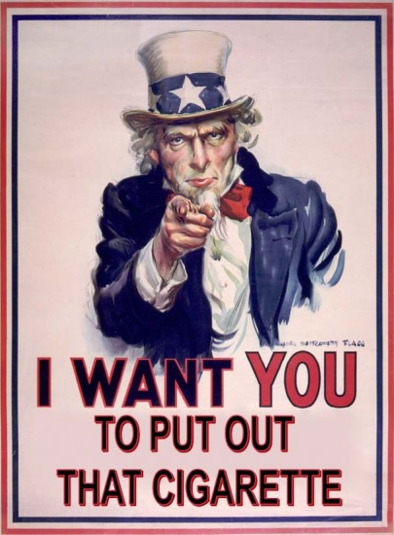
Most Americans live in a state or city that now bans indoor smoking.
That is due to the governmental policies that have regulated the use of tobacco.

Slide 11
Changes in Advertising
Local governments in North Carolina have the right to restrict “Power Walls”
Power Walls now banned in Canada
Notes:
Power Wall – large display behind cash register at convenience stores

Slide 12
September of 2012
Warning labels will be more explicit
Go to http://www.fda.gov/TobaccoProducts/Labeling/Labeling/CigaretteWarningLabels/default.htm to see 10 examples of new warning labels

Slide 13
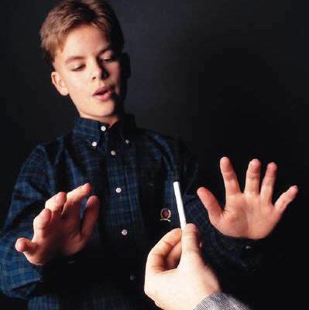
Do These Laws and Policies Work?
You Betcha!
The number of North Carolina middle school students who smoke has declined since 2007. 2011 NC MSRBS
Smoking has dropped 40%
in 100% tobacco-free
schools.
www.tobaccofreeschoolsnc.com

Slide 14
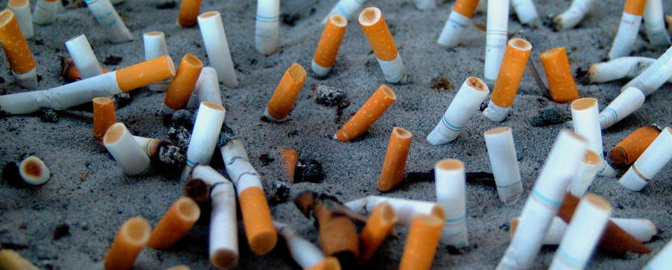
Help for Smokers
1-800-QUIT-NOW added to tobacco advertisements
Toll-free number to speak with a Quit Coach

