Slide 1

Physical Activity:
A Habit for Life
7.NPA.4.1
Design goals for increasing physical activity and strategies for achieving those goals.

Slide 2
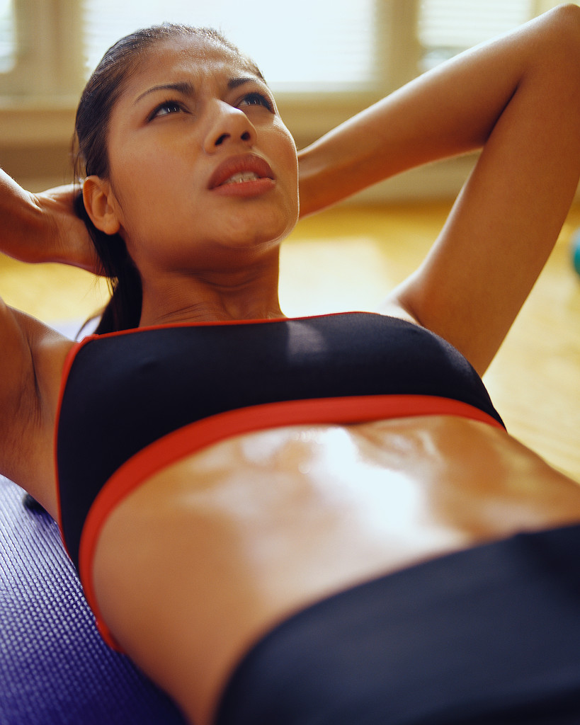
Warm Up Quiz
1. To improve health you must do high-intensity exercise.
T or F
2. The best time to stretch is after a workout.
T or F
3. If you want to lose fat around your middle to have a flat stomach, you should do sit-ups.
T or F

Slide 3
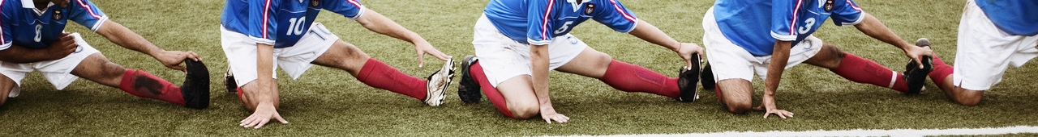
Warm up Answers
F - Moderate physical activity helps too!
T - Stretch farther and lower risk of injury when warm (different than warming up!)
F – Energy burn from doing sit-ups comes from all over the body, not just abs. To burn fat, must do cardio-respiratory exercise.

Slide 4
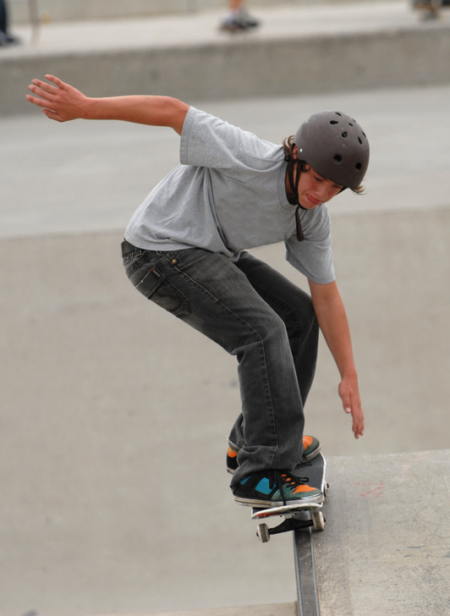
Objectives
Review the benefits of exercise
Explain the types of physical activity
Identify common barriers to exercise

Slide 5
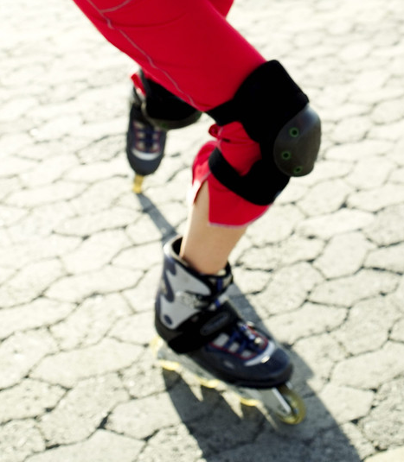
Benefits of Exercise
Improved cardio-respiratory (heart and lungs) functioning
More efficient metabolism
Improved body composition
Disease prevention/management
Improved immune function
Prevention of injuries
Improved wellness for life!

Slide 6
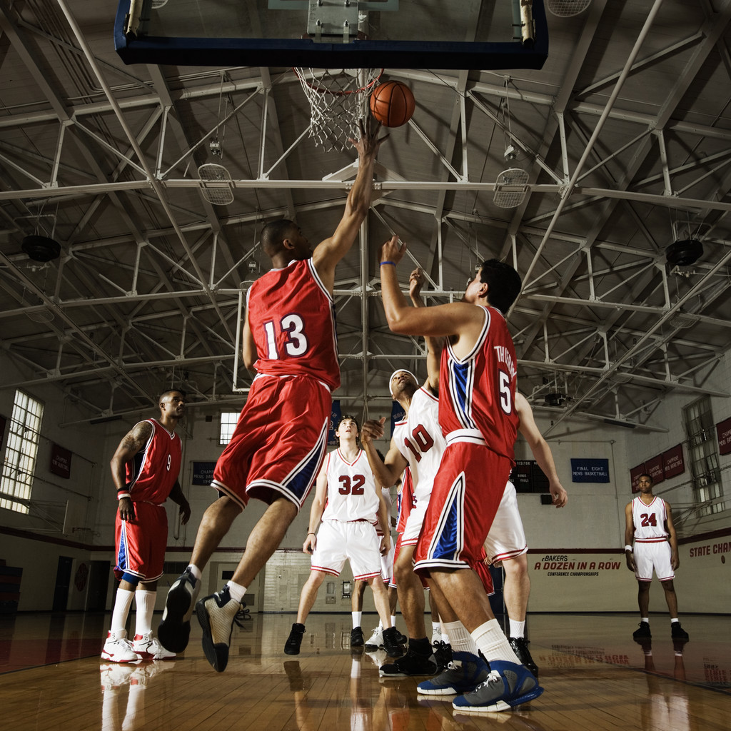
Also…Improves Psychological &
Emotional Wellness
Improves Self-Image
Reduces Stress
Reduces Anxiety and Depression
Enhances learning and Memory
Enjoyment

Slide 7
Amounts of
Physical Activity
It is recommended that children and adolescents participate in at least 60 minutes of moderate intensity physical activity most days of the week.
Physical activity doesn’t have to be strenuous to be beneficial.
Moderate amounts of daily physical activity are recommended for all ages. This amount can be obtained in longer sessions of moderately intense activities, such as brisk walking for 30 minutes, or in shorter sessions of more intense activities, such as jogging or playing basketball for 15-20 minutes.

Slide 8
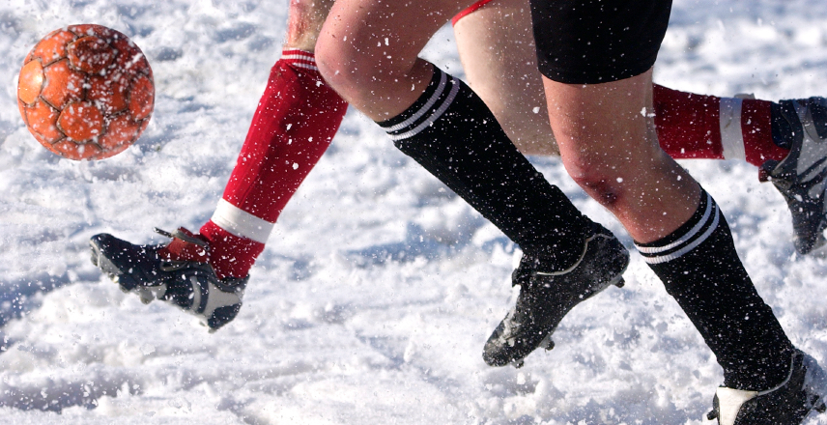
Types of Physical Activity
Endurance activities
Flexibility activities
Strength activities

Slide 9
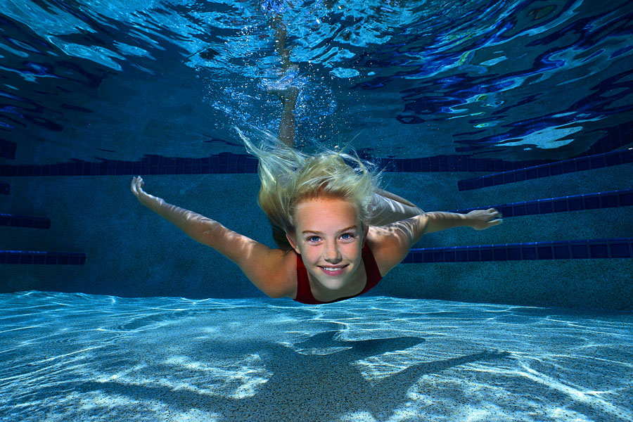
Activity to
Increase Endurance
Strengthens cardiovascular and respiratory systems, prevents heart attacks and strokes, reduces overweight and obesity
Includes walking, running, swimming, cycling, yard work, aerobic workouts
Recommended 4 to 6 days a week

Slide 10
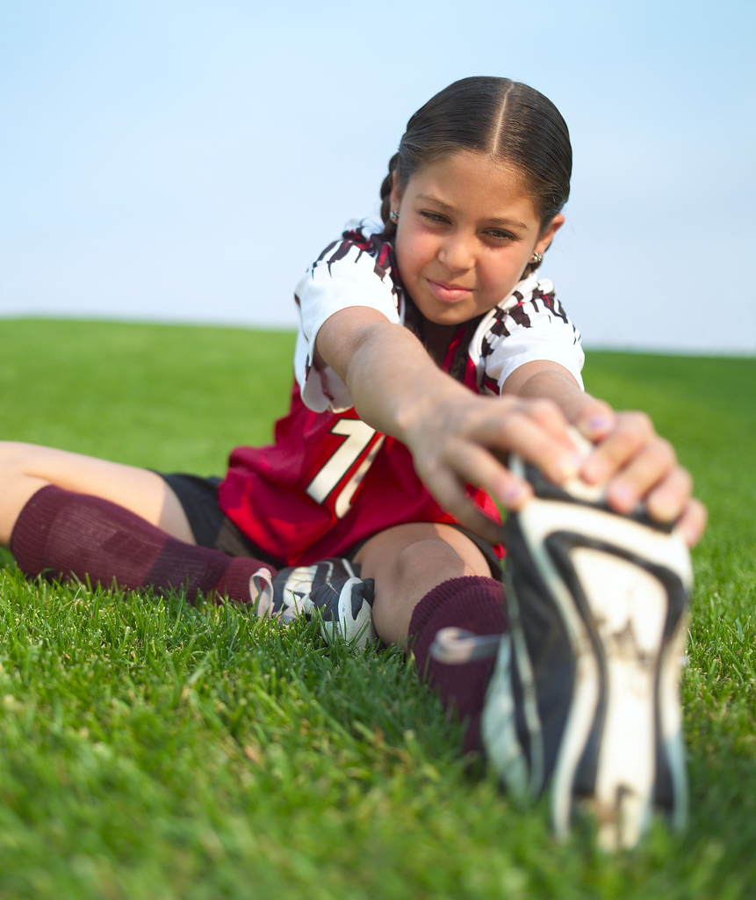
Activity to
Increase Flexibility
Helps you move easily, keeping your muscles relaxed and your joints mobile.
Helps prevent injury.
Stretch slowly and smoothly. Use gentle, continuous movement for 20-40 seconds.
Recommended 4 to 6 days a week.

Slide 11

Activity to
Increase Strength
Helps muscles and bones stay strong, improves posture, prevents osteoporosis
Includes lifting weights, push-ups and crunches, jumping
Recommended 2 to 4 days a week (rest at least one day between sessions)

Slide 12
How much time do we need to exercise?

Slide 13
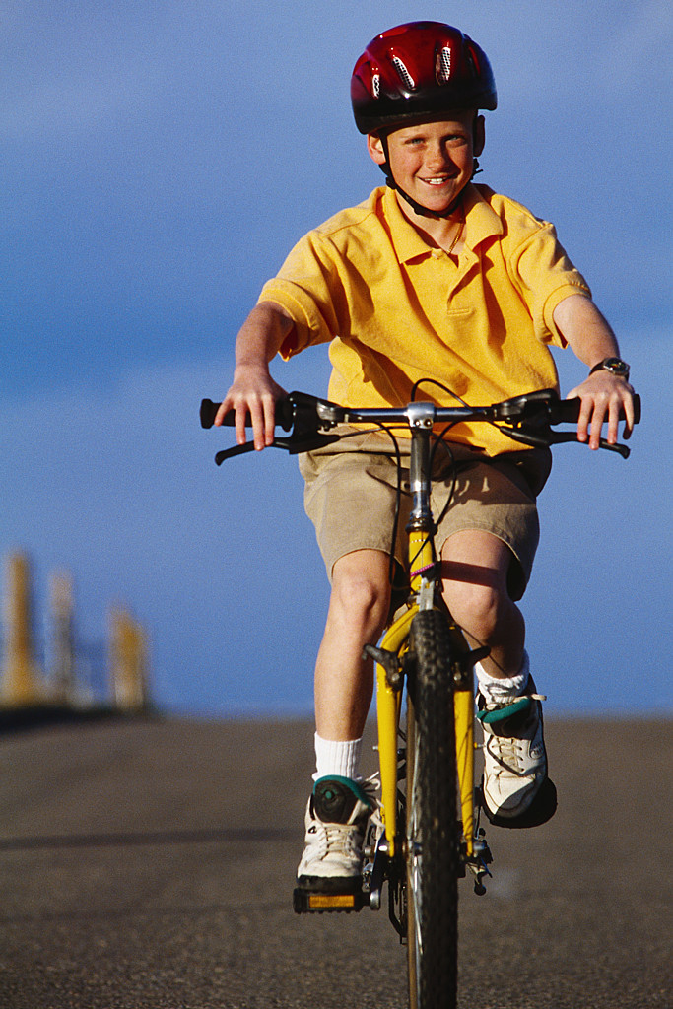
General Guide: Less vigorous, more time.
More vigorous, less time.
Washing and waxing a car- 45-60 minutes
Washing windows or floors- 45-60 minutes
Playing volleyball- 45 minutes
Playing touch football- 30-45 minutes
Gardening- 30-45 minutes
Wheeling self in wheelchair- 30-40 minutes
Walking 1.75 miles in 35 minutes (20 minutes/mile)
Basketball (shooting baskets)- 30 minutes
Bicycling 5 miles- 30 minutes
Dancing fast (social)- 30 minutes
Raking leaves- 30 minutes
Water aerobics- 30 minutes
Swimming laps- 20 minutes
Wheelchair basketball- 20 minutes
Basketball (playing a game)- 15-20 minutes
Jumping rope- 15 minutes
Walking stairs- 15 minutes

Slide 14
Barriers—Yikes!
Not enough time
Accidentally quit
Need a partner
Draw attention
Goals too far-fetched
No fun
Physical Problems
What are some of the most common barriers for you to exercise? How might you overcome at least two of these?

Slide 15
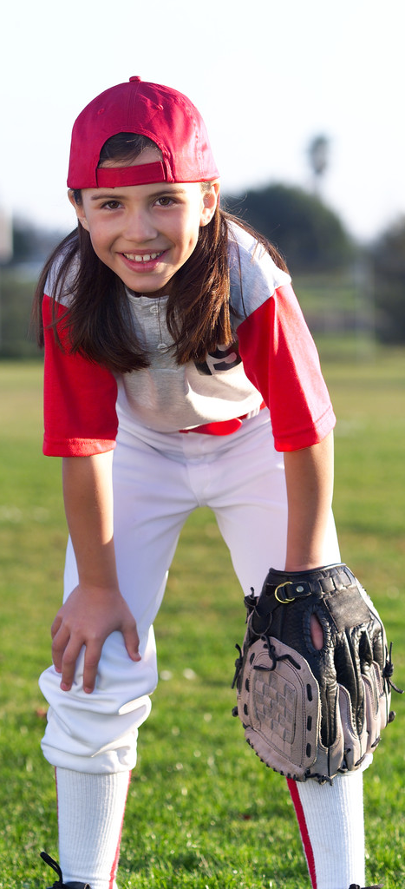
Tips for
Exercising Success
Choose fun activities
Add variety and alternate activities
Wear comfortable and proper exercise clothing
Choose a convenient time and place to exercise
Use music to entertain
Exercise with a friend
Don’t overdo it!

Slide 16
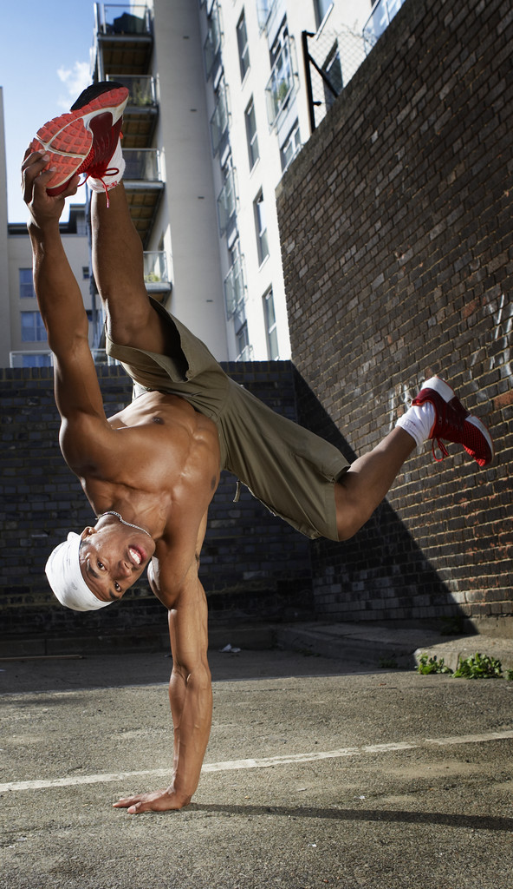
A few resources…
www.cdc.gov
www.usda.gov
www.fitness.gov
www.mypyramid.gov
www.americanheart.org
www.beactivenc.org
www.eatsmartmovemore.com

