Slide 1
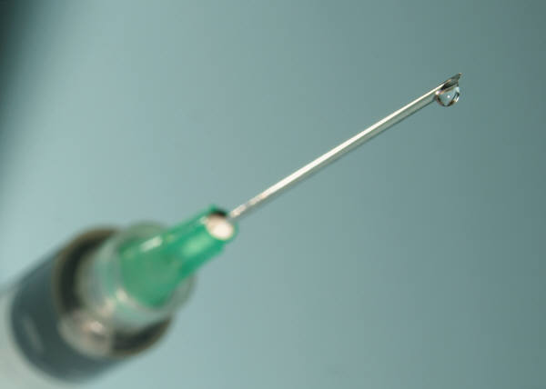
Health Risks Resulting from Injection Drug Use

Slide 2
Drugs most commonly used through injection are:
Cocaine
Heroine
Methamphetamines
Steroids
Notes:
Illegal drugs often injected are: Cocaine, Heroine, Methamphetamines, Amphetamines, additional stimulants and narcotics.
Legal – but sometimes abused and injected – Codeine, Morphine, Fentanyl (synthetic heroine)

Slide 3
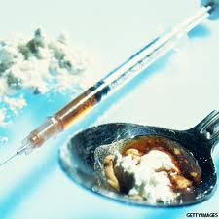
In the 2011 national Youth Risk Behavior Survey, 2.3% of high school students reported having injected an illegal substance during their lifetimes.

Slide 4
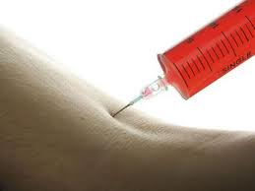
The injection site
Drugs can be injected into the body in many ways.
Injected just beneath the skin
Into the muscle
Directly into a vein
Notes:
When injecting a drug, the user may draw blood back into the syringe to make sure that he/she is injecting the drug directly into the vein or to “wash” the residue from the syringe to get all the drug within the syringe into their own blood stream – to get all the drug they can.

Slide 5
Health Risks
Overdose
The biggest risk to a heroine user is death by overdose.
It is impossible to judge the purity of street heroine.
Habit Forming
All the health risks continue each and every time!
Notes:
Adulterants – substances added to heroin to cut it. Also known as “laced” – Example: The heroine was laced with flour.
Known adulterants – nutmeg, sucrose, starch, caffeine, chalk, powdered milk, flour, talcum powder, laundry detergent, ajax cleaning powder …..the list goes on!

Slide 6
Health Risks (continued)
Risky Sexual Behavior
Due to the effects of drugs, it is not uncommon for users to engage in risky sexual behavior. HIV, Hepatitis B and Hepatitis C are contracted through the exchange of bodily fluids
Notes:
The CDC estimates that at least ¼ of those with the HIV virus do not know they have it. The statistics for Hepatitis is even higher. Not difficult to see why injection drug users are infecting others.

Slide 7
Health Risks (Continued)
Transmission of a blood-borne disease
Because there are laws controlling the purchase of needles, many injection drug users SHARE NEEDLES.
A virus can live in the used syringe up to four days.
HIV, Hepatitis B and Hepatitis C spread rampantly through the injection drug user community. Hepatitis affects the liver and can be fatal.
Notes:
Approximately half of injecting drug users contract Hepatitis within their first year of drug use.
The CDC reports that since the HIV epidemic began, 57% of all AIDS cases among women have been attributed to injection drug use or sex with partners who injected drugs. (31% in men – same statistic)
While the statistics show those with HIV are living longer, there is STILL NO CURE.

Slide 8
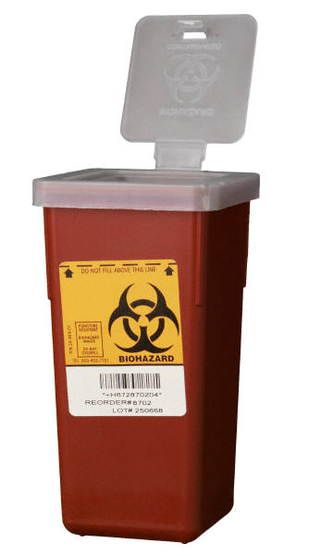
Biohazardous Waste Material
Remember, sometimes it is necessary to use needles to inject drugs
Example: Diabetics take insulin
Health Professionals administering vaccines
This is very different than experimenting with illegal drugs.
Caution – dispose of all needles properly in containers labeled “Biohazardous waste material”.
Never touch a needle that you find or you know has been used by someone else.
Notes:
Remind students that diabetics use insulin to balance their blood sugar.

