Slide 1
Peer Pressure
The influence exerted by a peer group encouraging a person to change his or her attitudes, values, or behavior in order to conform to group norms.

Slide 2
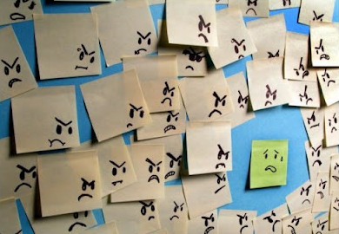
How does peer pressure feel?

Slide 3
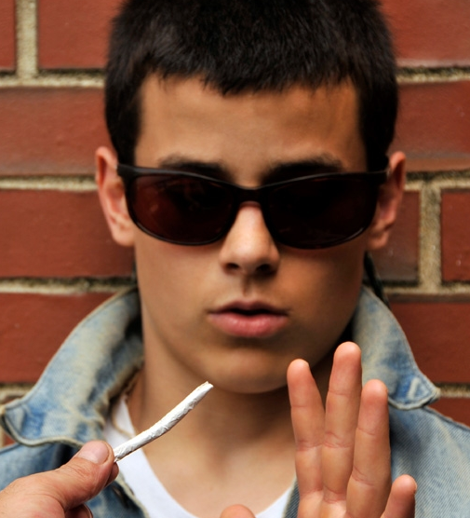
Both! What is an example of positive peer pressure? What is an example of negative peer pressure?
Positive? or Negative?

Slide 4
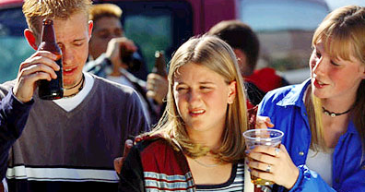
Three Models of Assertive Refusal
Say “no” firmly and keep repeating it.
Take the offensive. Let the person know how the continued pressure makes you feel.
Refuse to discuss the matter any further. Leave.

Slide 5
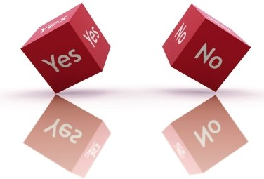
Why is it difficult to resist negative peer pressure?

Slide 6
How does it feel when we are successful?

