Slide 1
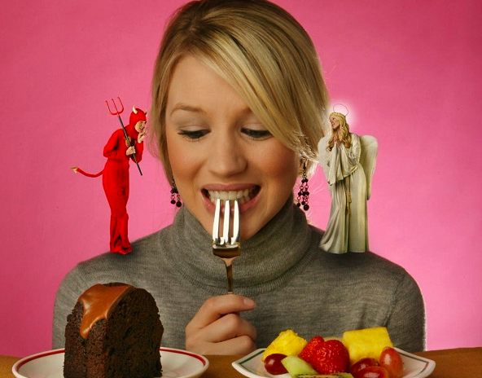
Overcoming Barriers to Healthy Eating

Slide 2
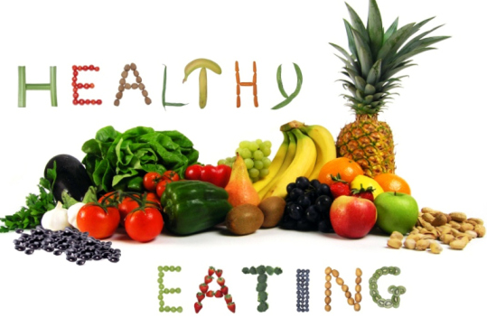
What are Characteristics of Healthy Eating?
Consuming a balance of nutrients
. . .
. . .
. . .
. . .
. . .

Slide 3
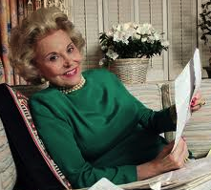
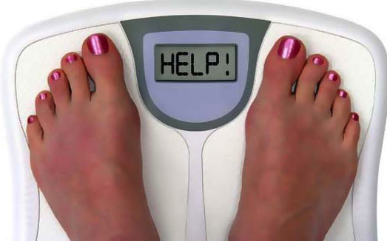
Ann Landers, an advice columnist, stated: “If any of the fad diets worked, we would not need another one next year.”

Slide 4
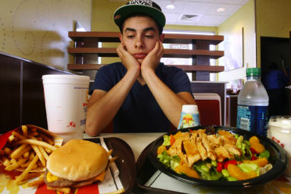
Are YOU in Control?
You select which line to get in at the food court.
. . .
. . .
. . .
. . .

Slide 5
How Unhealthy Eating Affects Health (specifically fad diets)
Fad diets limit the variety of foods eaten.
Fad diets may be nutritionally unsound.
Most fad dieters regain all the weight lost and gain more weight.
Some fad diets encourage a weight loss that is greater than 1-2 pounds a week which results in loss of water and muscle.
Metabolism slows with dieting and makes it more difficult for healthy weight loss.

Slide 6
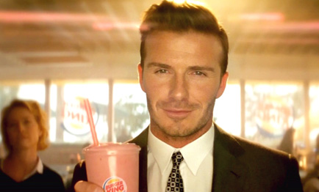
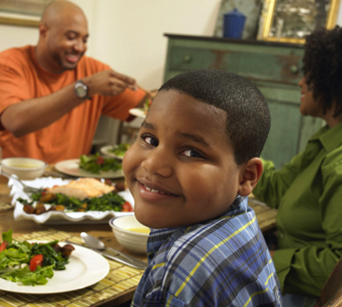
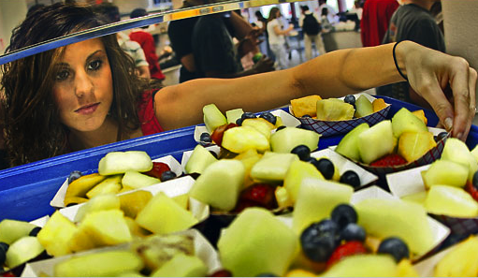
Who and What Influences Eating?

Slide 7
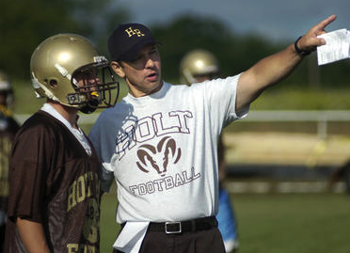
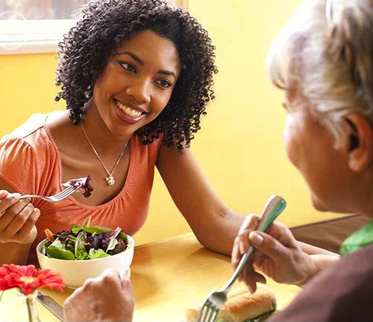
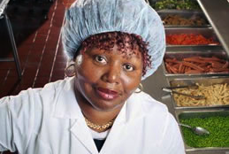
Who are Resources?

Slide 8
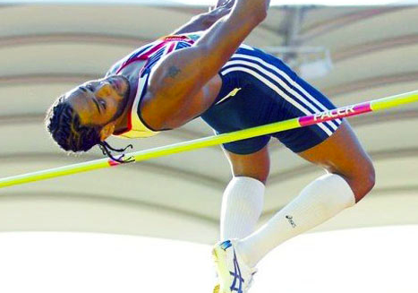
Overcoming Barriers

