Slide 1
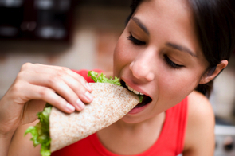
What is Normal Eating?

Slide 2
Normal eating is . . .
being able to eat when you are hungry and continue eating until you are satisfied. It is being able to choose food you like and eat it and truly get enough of it—not just stop eating because you think you should.

Slide 3
Normal eating is . . .
being able to use some moderate constraint in your food selection to get the right foods, but not being so restrictive that you miss out on pleasurable foods.

Slide 4
Normal eating is . . .
giving yourself permission to eat sometimes because you are happy, sad, bored, or just because it feels good.

Slide 5
Normal eating is . . .
three meals a day most of the time but it can also be choosing to munch along. It is leaving some cookies on the plate because you know you can have some again tomorrow, or it is eating more now because they taste so wonderful when they are fresh.

Slide 6
Normal eating is . . .
overeating at times; feeling stuffed and uncomfortable. It is also undereating at times and wishing you had more.

Slide 7
Normal eating . . .
trusts your body to make up for your mistakes in eating. Normal eating takes up some of your time and attention but keeps its place as only one important area of your life.

Slide 8
In short, Normal eating is Flexible.
It varies in response to your emotions, your schedule, your hunger, and your proximity to food.

Slide 9
Eating Disorders

Slide 10
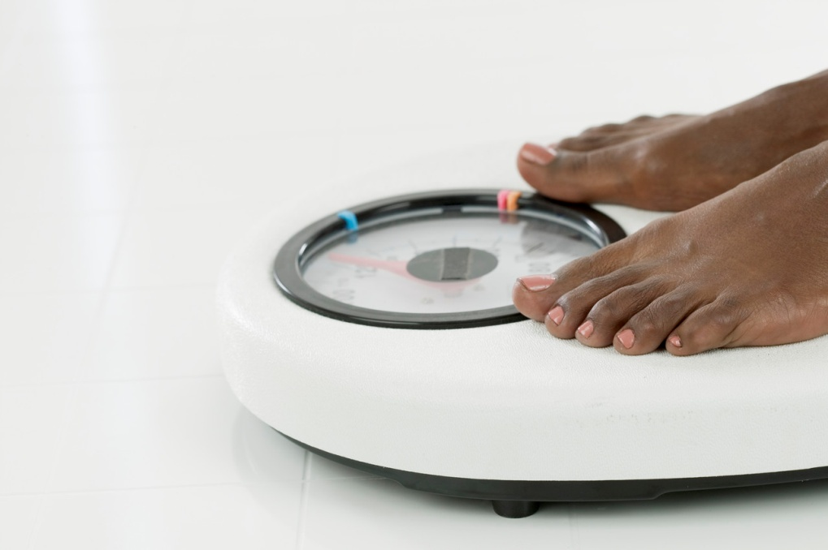
Three Main Kinds of Eating Disorders
Anorexia
Bulimia
Binge Eating Disorder

Slide 11
Anorexia
Drops weight to about 20% below normal
Denies feeling hungry; self-starvation
Obsession with food
Exercises excessively (hours per day)
Very thin, but feels fat
Conflict with family and friends about eating
Often has depression, anxiety

Slide 12
Bulimia
Binge (eats huge amounts of food in short period of time) and purge (vomiting, laxatives, diuretics)
Has excuses to go to the bathroom immediately after meals
Withdraws from social activities

Slide 13
Bulimia
May over-exercise
Feel depressed, helpless
Weight often normal

Slide 14
Binge Eating Disorder (compulsive overeating)
Binge (huge amount of food in short period of time) at least twice a week, continues over a period of time—at least 6 months, and causes distress or problems in the person’s life
Usually binges alone and cannot stop when full; eats large amounts of food even when not hungry

Slide 15
Binge Eating Disorder
Feels out of control and then depressed, guilty, or disgusted
Gains weight excessively; often overweight

Slide 16
Causes of Eating Disorders
Eating disorders start about 11 – 14 years (may start as early as 7)
No single cause; still are not sure of all causes
May not feel good inside so a person tries to change outside
Low self-esteem

Slide 17
Causes of Eating Disorders
Depression or stress and lack of feeling of control
Sports that emphasize weight (such as wrestling or ballet)
Families (may have eating disorders or overly emphasize weight)
Media pressure to be thin, attractive

Slide 18
Effects of Eating Disorders

Slide 19
Anorexia
Without treatment, can cause death
Loss of menstrual cycle
Heart, liver and kidney damage
Low blood pressure, pulse, and breathing rate

Slide 20
Anorexia
Hair loss and brittle fingernails
Feel cold (even in warm weather)
Headaches, dizziness, and concentration difficulties
Withdrawal and depression

Slide 21
Bulimia
Loss of potassium which can lead to heart problems, death
Tooth decay
Swollen glands in face (chipmunk cheeks)

Slide 22
Bulimia
Stomach pain
Stomach and kidney damage
Withdrawal and depression

Slide 23
Binge Eating Disorder
Overweight (which can make it difficult to get around and increases risk for chronic diseases such as heart disease and diabetes)
Breathing and sleep difficulties due to overweight
Withdrawal and depression

