Slide 1
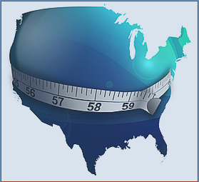
BMI Rise in America

Slide 2
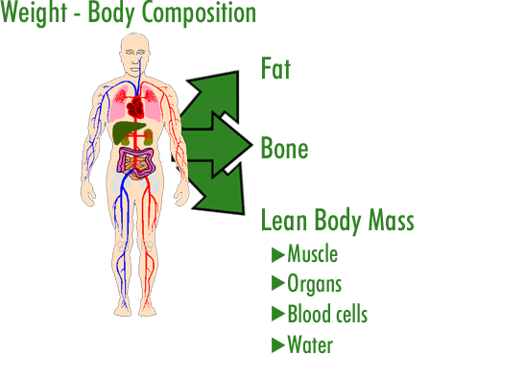
BMI What is it?
Body Mass Index (BMI)
→ A formula that includes height and weight to measure a person’s lean-to-fat composition.
Body Composition
Refers to the percentages of fat, and fat-free mass (muscle and bone) in the body.
Healthy Goal:
Low fat percentage and higher fat-free mass percentage

Slide 3
BMI % Classifications:

Slide 4
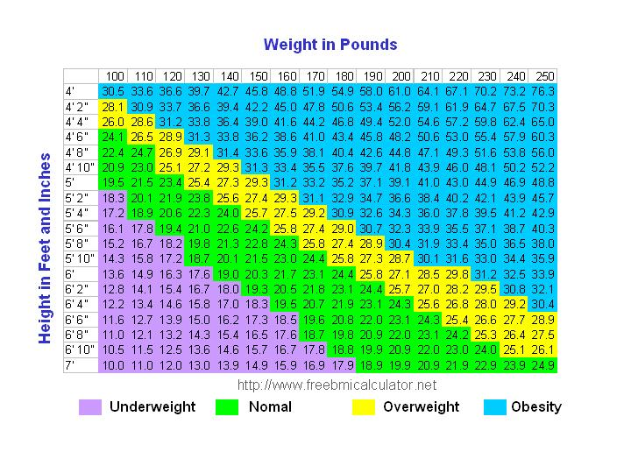
-BMI is a reliable indicator of body fatness for most children and teens.
-Inexpensive and easy-to-perform method.
-BMI does not measure body fat directly.

Slide 5
Calculating Your BMI:
Weight(lb) / [Height (in)]^2 X 703
-For example: (Weight=150 lbs. Height= 5’5” (65”)
Calculation→ [150/(65)^2]x 703 = 24.96

Slide 6
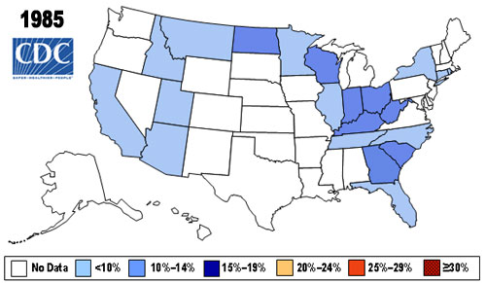
BMI Through the Years… Overweight: 25%-19% Obese: >30%

Slide 7
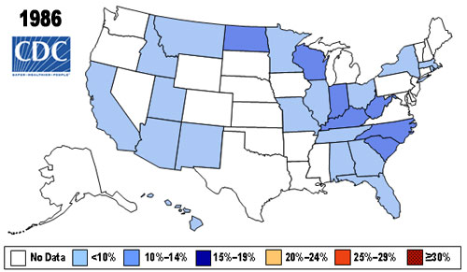

Slide 8
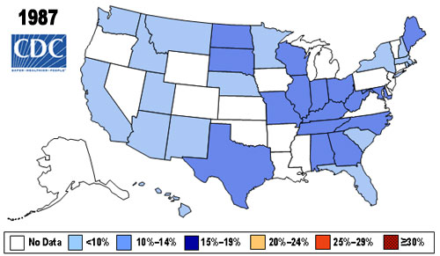

Slide 9
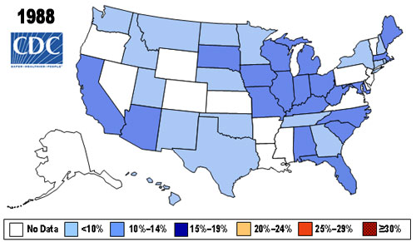

Slide 10
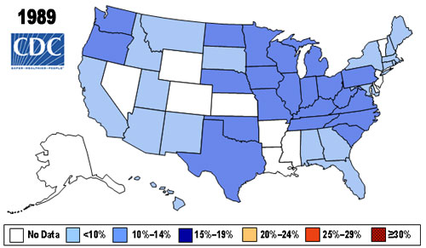

Slide 11
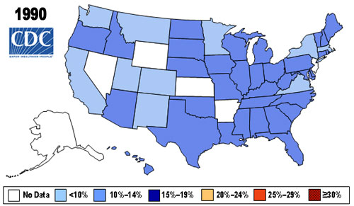

Slide 12
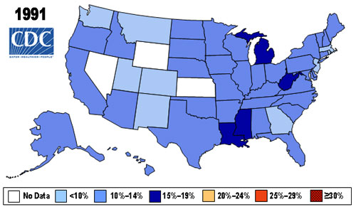

Slide 13
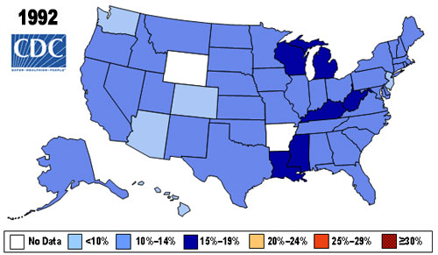

Slide 14
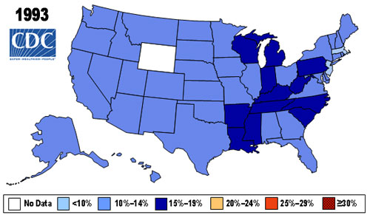

Slide 15
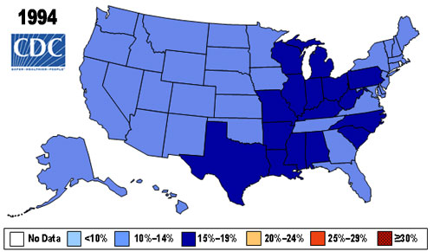

Slide 16
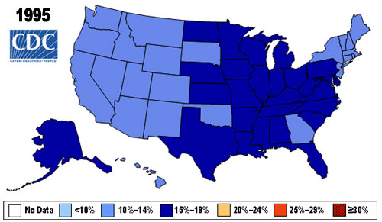

Slide 17
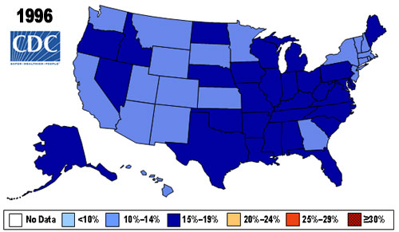

Slide 18
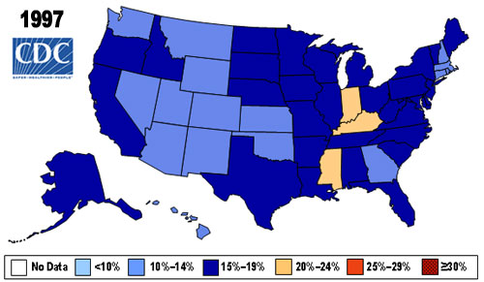

Slide 19
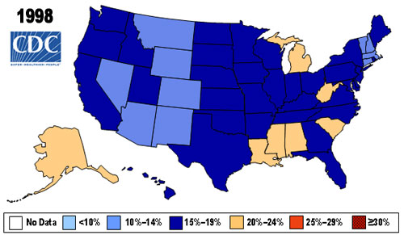

Slide 20
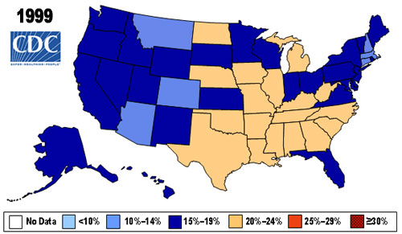

Slide 21
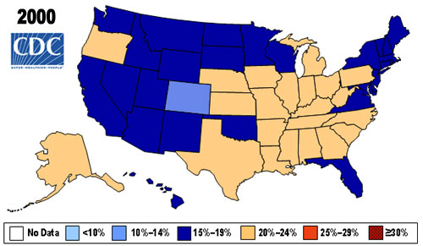

Slide 22
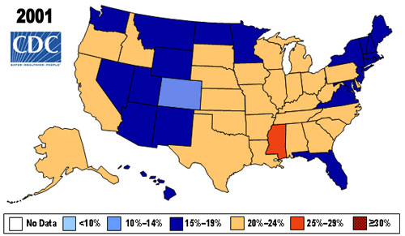

Slide 23
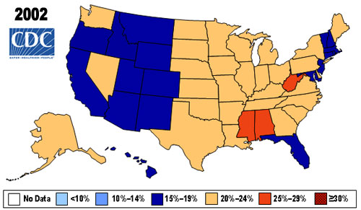

Slide 24
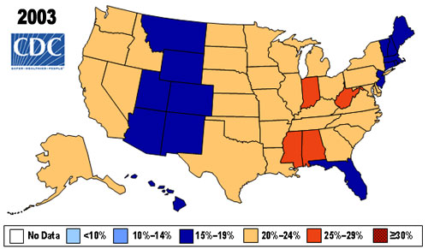

Slide 25
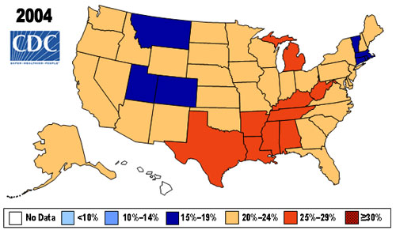

Slide 26
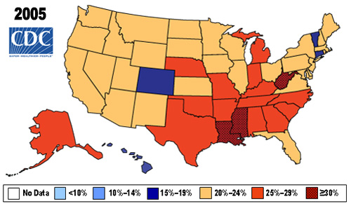

Slide 27
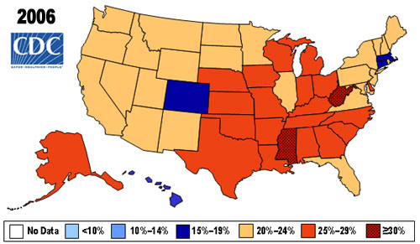

Slide 28
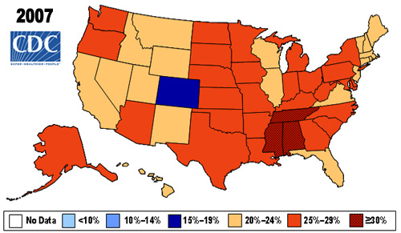

Slide 29
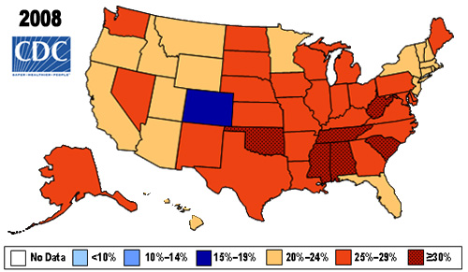

Slide 30
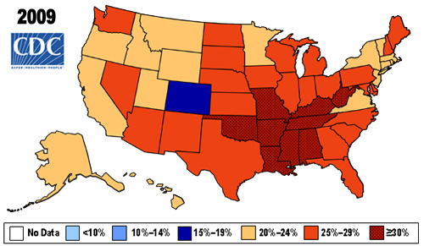

Slide 31
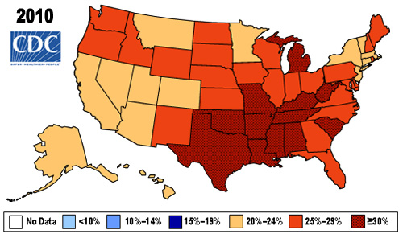

Slide 32
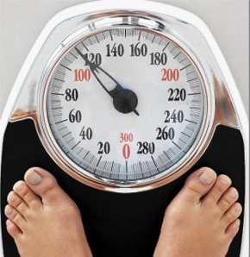
Other ways to determine body fat:
Scale-
Standing scales includes fat, body fluids, bone, muscle, other tissues, and perhaps clothes.
Common household item and very simple to use.
→ Because scale weight doesn’t isolate fat, it is considered less useful of a measure.

Slide 33
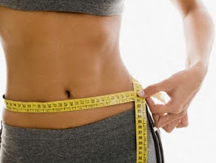
Other ways to determine body fat:
Waist-to-Hip:
-Accounts for more abdominal fat.
Uses a non-stretchable tape measure to measure waist at its narrowest point. (Usually above the belly button).
Then measure hips around the widest part of hip bones.
Divide waist by the hip measurement to determine.

Slide 34
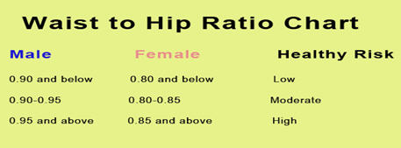
Strengths and Weaknesses of Waist-to-Hip:
Strengths
- Good way to know whether someone is at increased risk for heart disease/diabetes.
-Easy to do.
Weakness
- Does not indicate how much fat or how much muscle a person has so it is not precise.

Slide 35
Calculate your BMI
Use the BMI tool on the CDC.gov website to determine your BMI.
-Go to http://apps.nccd.cdc.gov/dnpabmi/
-Put in your information and record your BMI percentage.
-Then compare your percent measure to standards for underweight, normal weight, overweight, or obese.

