Slide 1
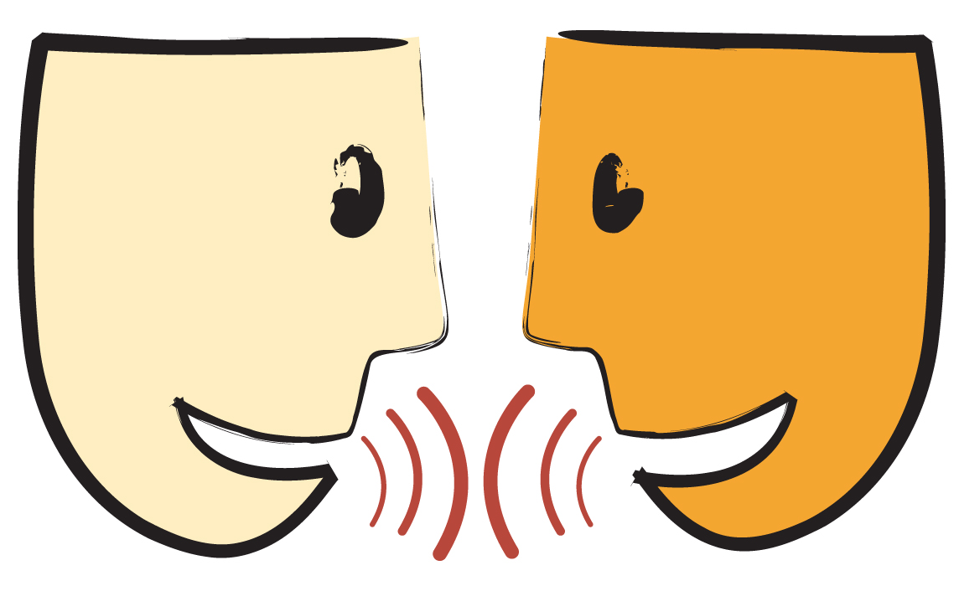
Communication Skills

Slide 2
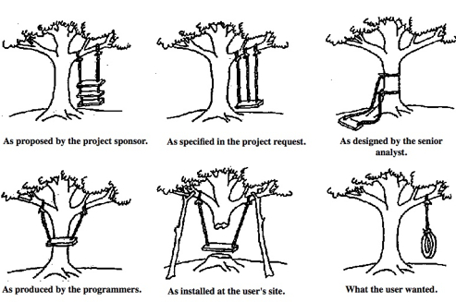
What’s Wrong with This Picture?

Slide 3
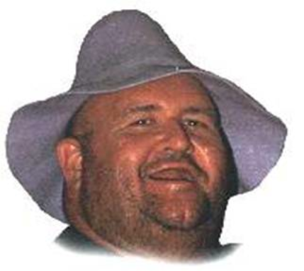
Bubba Had Shingles

Slide 4
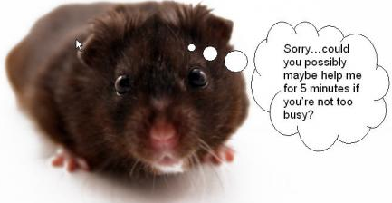
What We’ve Already Learned about Communication
Passive: offering no opinion or resistance
Aggressive: communicating in a rude or disrespectful way
Assertive: stating opinion in a respectful or positive way
The hamster is an example of what kind of
communication?

Slide 5
Steps for “I” Messages
Tell the person what bothered you.
Tell the person the effect that his/her behavior had on you.
Tell the person how this behavior made you feel.

Slide 6
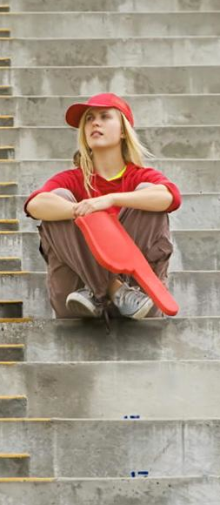
An Example of an “I” Message
“When you went to the concession stand at halftime and never came back to sit with me, I had to sit alone for the rest of the ballgame. I was embarrassed and angry.”

Slide 7
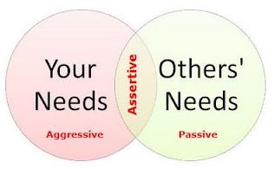
Why is Assertive Communication a “Win-Win?”

