Slide 1

PCH.4.1 Deconstruct how the interaction of individual behaviors, the environment, and other factors cause or prevent injuries.
Grade 7
Life Path B
Life Path A

Slide 2
Objectives
The student will examine current data on intentional and unintentional injuries.
The student will provide examples of behavioral and environmental factors that can prevent or increase injuries.
The student will avoid risk-taking behaviors and unsafe environments.
The student will practice injury prevention and protect self and others from injury.

Slide 3
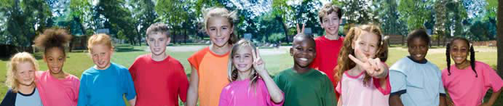
True or False…
Injuries are the leading cause of death for people ages 1–44.

Slide 4

TRUE
According to the Centers for Disease Control and Prevention, more than 180,000 people die from injuries each year—1 person every 3 minutes.

Slide 5
True or False
There are different types of injuries.

Slide 6
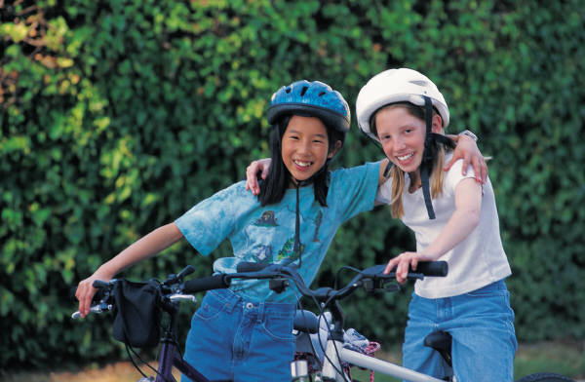
TRUE
Injuries are classified as
Intentional: done by someone else or the individual
  result of acts of violence: assault, murder, self-harm, and suicide
Unintentional: not planned
  Examples include: falls, motor vehicle incidents, poisoning, drowning, suffocation and strangulation, fire, and head injuries

Slide 7
True or False…
Accidents happen. People can’t prevent an accident.
Notes:
Let’s start by addressing some of the data about cause of injury or death

Slide 8
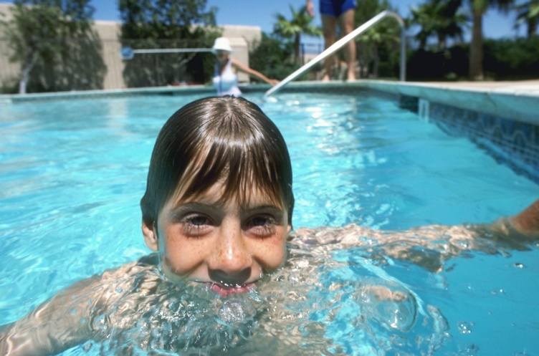
FALSE
Most accidents, better called unintentional injuries, can be prevented by making healthier choices.
Such as:
  Wearing a seat belt
  Not taking dares
  Learning to swim
  Using a helmet and other protective gear
  Not using alcohol or other drugs

Slide 9
True or False
Cyber-bullying (through texts, instant messaging or FB) is considered to be an act of violence or aggression.

Slide 10

TRUE
Experts call it “electronic aggression.”
Most state have created laws to address this issue.
NC House Bill 1261, passed in 2009, made cyber bullying a criminal offense.

Slide 11
True or False…
Alcohol and other drugs contribute to the likelihood of all injuries.

Slide 12

TRUE
Alcohol and other drugs increase the chances of intentional and unintentional injuries.
In 2010, more than 10,000 people died in alcohol-impaired driving crashes - one every 51 minutes.

Slide 13
True or False
In North Carolina middle schools, most students report wearing sunscreen with an SPF of 15 or higher when they are outside for more than one hour on a sunny day.

Slide 14

FALSE
The physical and social environment can contribute to injuries, as well. These factors may include sun exposure, temperature, or personal safety.
Unfortunately, only about 1 in 8 NC middle school students report frequent sunscreen use.

Slide 15
True or False
Kids who wear helmets or other protective gear are wimps.

Slide 16

FALSE
Professional athletes use protective gear!
More than 3.5 million kids under age 14 receive medical treatment for sports injuries each year.
The average age of people injured or killed in bicycling accidents were between 5 and 15 years old.

Slide 17
True or False
In North Carolina middle schools, most students (boys and girls) play on one or more sports teams.

Slide 18
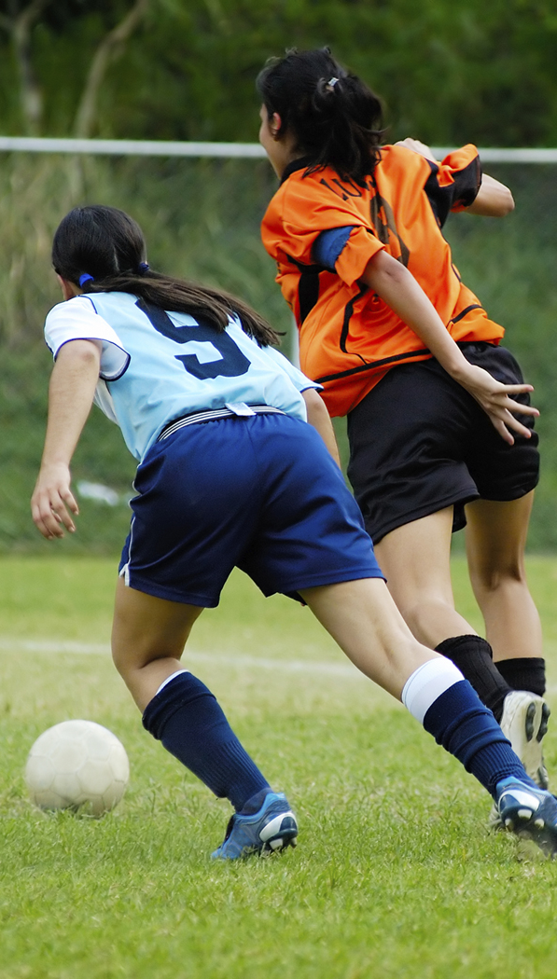
TRUE
That’s great! Team sports are an excellent way to develop strong relationships AND strong bodies.
However, don’t forget your protective gear!

Slide 19
True or False
It’s okay to take a friend’s medication…a doctor prescribed it, right?

Slide 20

FALSE
According to the National Institute on Drug Abuse, virtually every medication presents some risk of undesirable side effects, sometimes even serious ones. Doctors consider the potential benefits and risks to each patient before prescribing medications.
Poisoning deaths among teenagers rose 91% between 2000 - 2009, mostly due to prescription drug abuse.

Slide 21
True or False
It is illegal to carry a weapon into a North Carolina school.

Slide 22
TRUE
According to the NC Department of Public Instruction, it is unlawful for any person to possess or carry, whether openly or concealed, weapons on campus or other educational property including:
  BB guns, air rifles, knives, razors and razor blades, fireworks, or any sharp-pointed or edged instrument

Slide 23
True or False
I heard that seatbelts don’t really work…you might get trapped in the car!

Slide 24

FALSE
Seatbelts save lives!
According to the National Highway Traffic Safety Administration, if all passenger vehicle occupants over age 4 had worn seat belts, 20,824 lives (that is, an additional 5,441) would have been saved in 2006.

Slide 25
True or False
In North Carolina middle schools, most students report that they have ridden in a car or other vehicle driven by someone who had been recklessly speeding.

Slide 26
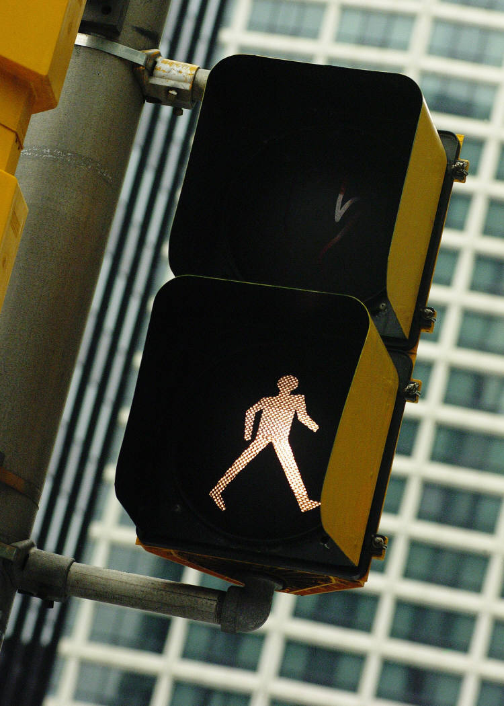
FALSE
MOST NC middle school students report that they have NOT done this!
Way to show good judgment and sense. Driving requires a lot of responsibility. Don’t let friends pressure you into unsafe activities.

Slide 27
True or False
People my age don’t commit suicide.

Slide 28

FALSE
Unfortunately, young people do commit suicide. It is the second leading cause of death for young people, 10 – 19.
If you (or someone you care about) have experienced suicidal thoughts, GET HELP!
Contact a trusted adult or call 911.

Slide 29
True or False
In North Carolina middle schools, most students have seen other students being bullied in their school.

Slide 30

TRUE
Unfortunately, almost 3 out of 4 students in grades 6, 7, and 8 report that they’ve seen classmates bullied by others.
Don’t be a bystander, be an upstander! Help others and get your friends involved.

Slide 31
Summary
Unintentional injury is the leading cause of death for young people.
Intentional injuries (violence and suicide) are the second and third leading causes of death for young people.
These health issues also compromise the quality of life for those who survive.
Often injuries are influenced by the behavior of the individual and the environment in which he or she lives.
Have a plan!

Slide 32

Questions?

Slide 33
Sources
Centers for Disease Control and Prevention
Live Strong
National Institute of Mental Health
National Institute on Drug Abuse
National Highway Traffic Safety Administration
NC Department of Public Instruction
NC General Assembly
NC Healthy Schools

