Slide 1
Obesity in Childhood
About 1/3 of American children
are overweight or obese.

Slide 2
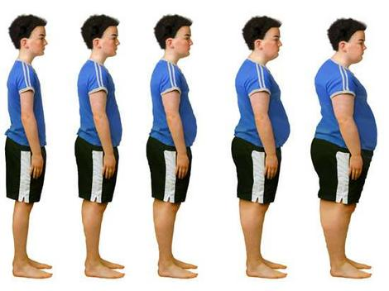
The childhood obesity epidemic is increasing . . .

Slide 3
Obesity Trends* Among U.S. Adults BRFSS, 1990, 1999, 2009
(*BMI ≥30, or about 30 lbs. overweight for 5’4” person)
1990
1999
2009
No Data <10% 10%–14% 15%–19% 20%–24% 25%–29% ≥30%

Slide 4
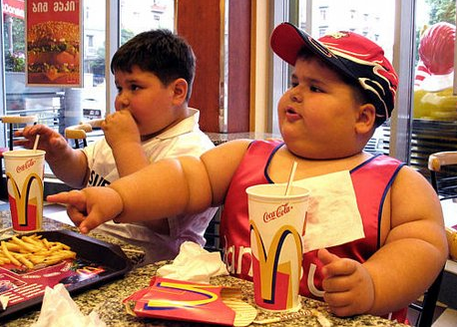
Childhood obesity is doubling every couple of decades . . .

Slide 5
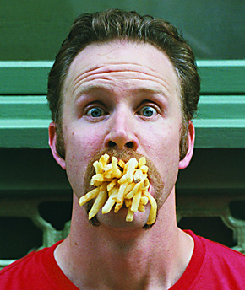
Americans spend $150 BILLION at
fast food restaurants each year.

Slide 6
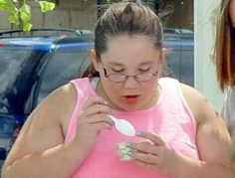
Effects of Childhood Obesity
Type-2 Diabetes
Metabolic Syndrome
High Blood Pressure
High Cholesterol
Asthma
Early Puberty
Sleep Disorders
Low self-esteem

Slide 7
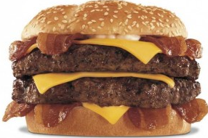
“In essence, the fat taste is just a habit, created by conditioning. All too often, high-fat foods or sweets are held out as rewards to children for ‘good behavior’.”
Dr. Leann Birch at the University of Illinois Child Development Laboratory has found that in Western countries, young children are conditioned or taught to like animal-based foods.

Slide 8
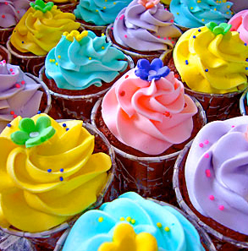
“For example, how many times have you heard parents say, ‘You can have your ice cream if you eat your spinach?’ They quickly assume that if ice cream is the reward, then spinach must be the punishment.
The late Charles Attwood, MD, Low-Fat Prescription for Kids

