Slide 1
Cigarette and Tobacco Advertising

Slide 2
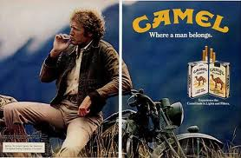
Advertising Appeals?
Sex Appeal
Gender Appeal
Fun/Relaxation Appeal
Slogan
Any others?
Notes:
Before displaying the advertising appeals, ask the class to view their Advertising Appeals worksheet and have them name a few advertising appeals that apply to this ad. Once students have participated, click the mouse to reveal each appeal and discuss the advertisement.

Slide 3
Gender Appeal
Sex Appeal
Youthfulness Appeal
Sophistication Appeal
Slogans
Group Identification
Notes:
Conduct the same activity as the last slide by asking the class to participate in finding the advertising appeals of Virginia Slims. Emphasize the difference between the two ads in context to gender.

Slide 4
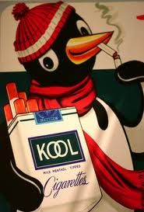
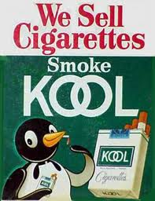
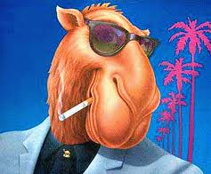
Animations
“Today’s teenager is tomorrow’s potential regular customer, and the overwhelming majority of smokers first begin to smoke while still in their teens…The smoking patterns of teenagers are particularly important to Philip Morris.”
Notes:
Explain that 90% of smokers begin during their years as a teenager. Therefore, tobacco companies consciously try to advertise towards these age groups. If you do not smoke through you adolescent years, your chances of ever smoking are much much lower.

Slide 5
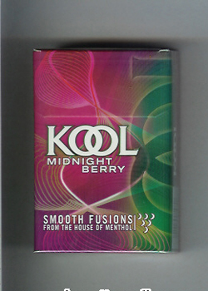
Candy Flavored Cigarettes?
Flavored cigarettes such as Kool’s Midnight Berry are now illegal in the U.S.
Notes:
Emphasize how this marketing strategy was blatantly implemented to target our nations youth and to encourage future generations to take up smoking.

Slide 6
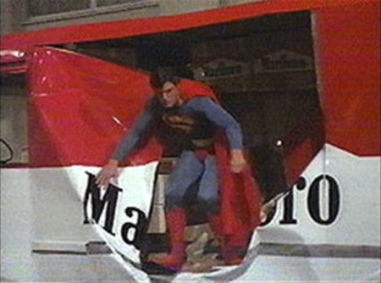
Better than a Commercial?
http://www.youtube.com/watch?v=KPeQ-fO2TZA
"Film is better than any commercial that has been run on television or in any magazine, because the audience is totally unaware of any sponsor involvement."
Notes:
Explain that even though tobacco commercials have been banned from television since the early 70’s, tobacco products are still seen in movies and television shows, influencing many who watch movies and television. Also, it is interesting to know that the Marlboro truck seen in this movie does not even exist in real life!

